Slide 1
Databases 9
Lecture 9. Query plan. Query optimization. Part 1

Slide 2
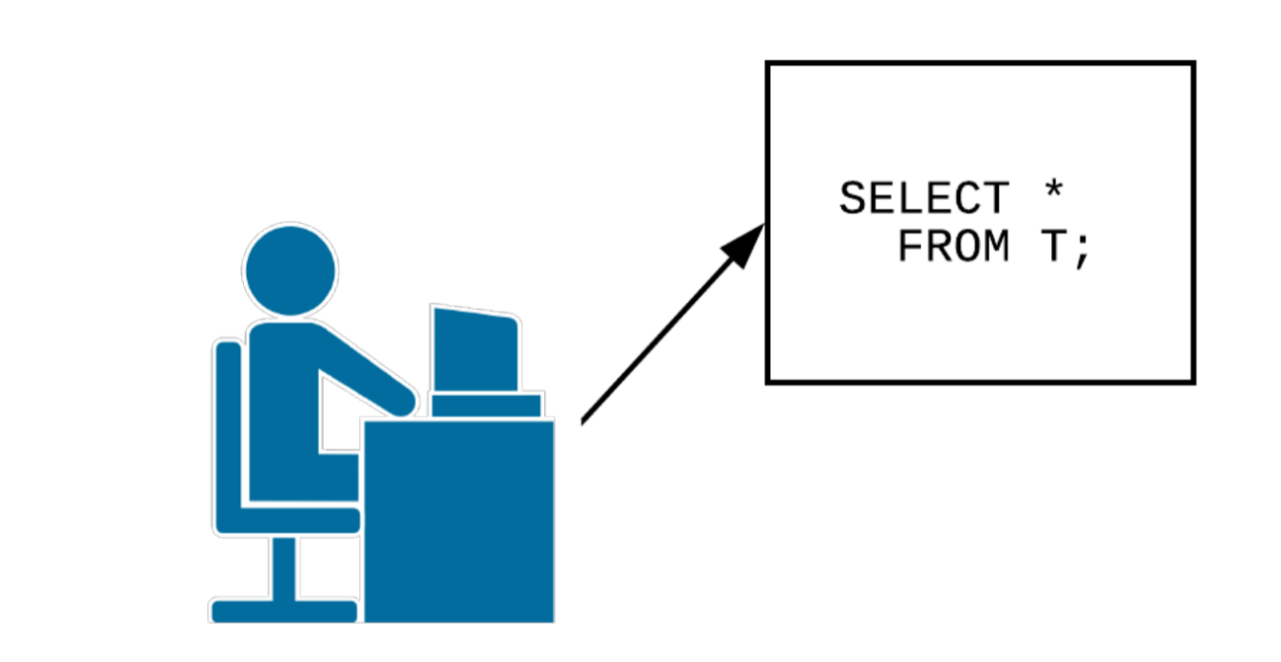
You have written a request. What's next?

Slide 3
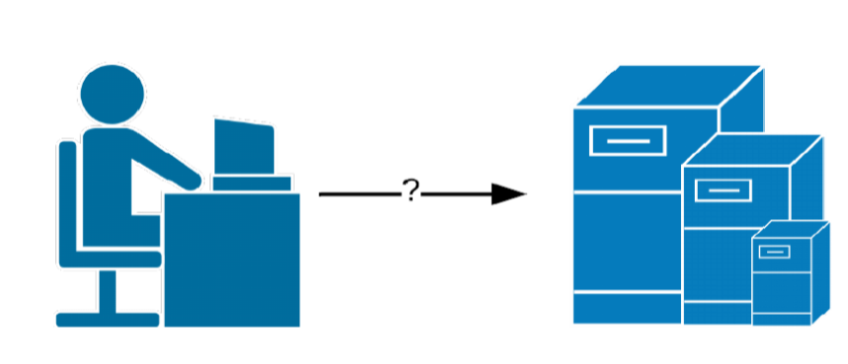
Connecting to a DBMS
The client process accesses the main server process
The main server process creates a new one when requesting a connection
When the connection is established, the client can send a request to the server
The request will be transmitted in plain text
There is no request processing at this stage

Slide 4
Request parsing
The parser checks the request for the correct syntax
The parser returns the result of the work:
Parse tree, if the syntax is correct
Error if the syntax is incorrect. The user gets an error
The converter accepts the parse tree as input and converts it into a query tree:
An understanding is formed of which tables, functions and operators the query uses
Accessing the database only within transactions

Slide 5
Request Tree
Special internal representation of SQL queries with its full analysis by key parameters:
Type of command (SELECT, UPDATE, DELETE, INSERT)
List of relationships used
The target ratio in which the result will be recorded
A list of fields (* is converted to a complete list of all fields)
A list of restrictions (which are specified in WHERE)
A list of joins
Other parameters, for example, ORDER BY

Slide 6
The system of rules
What are you doing:
CREATE VIEW myview AS SELECT * FROM mytab;
What's really going on:
CREATE VIEW myview (same column list as mytab);
CREATE RULE "_RETURN" AS ON
SELECT TO myview DO INSTEAD
SELECT * FROM mytab;

Slide 7
Query rewriting system
The request tree is accepted as input
References to views are replaced with tables using a system of rules
The system returns an updated query tree

Slide 8
Scheduler / Optimizer
The task of the scheduler/optimizer is to build the best
execution plan:
The same SQL query can be executed in different ways
The result of their execution will be identical
Different numbers of resources are spent on different methods
The result of the scheduler is a query plan

Slide 9
Request execution
The output takes the plan (tree) of the request
The handler recursively bypasses the request plan
When accessing each node of the plan, the following should be obtained 1 or more rows, or a message that the output of rows is completed

Slide 10
Request lifecycle:
A connection to the DBMS is being created. A request is sent to the DBMS.
The parser checks the correctness of the query syntax and creates a query tree.
The query rewriting system transforms the query.
The scheduler/optimizer creates a query plan.
The handler recursively traverses the plan and gets the rows.

Slide 11
How queries are executed
User sends SQL query
Database server:
Parses the query lexically (lexical analyzer) – identifies tokens (keywords, string and numeric literals)
Parses the request syntactically (parser) - makes sure that the resulting set of lexemes corresponds to the grammar of the language
Result: the request is represented in the memory of the serving process as an abstract syntax tree

Slide 12
How queries are executed
Parses a query semantically (semantic analyzer) - determines whether there are tables and other objects in the database that the query refers to by name, and whether the user has permission to access these objects
Result: the parse tree is rebuilt, supplemented with links to specific database objects, indicating data types and other information
Transforms (rewrites) a query - to restrict access at the row level, replace parse tree nodes with subtrees (for example, in the case of views or subqueries)
Schedules the request. At this stage, a plan tree is built, the nodes of which contain not logical, but physical operations on data

Slide 13
Planner
The planner is a PostgreSQL component trying to work out the most efficient way to execute an SQL query.
The execution plan contains information about how the database server will organize the viewing of the tables involved in the request.

Slide 14
Query planner
The scheduler uses a cost optimizer. Essentially this means that the scheduler:
will build several query execution plans
will determine their conditional cost (depending on the amount of data and processor resources)
will choose the most optimal plan (but this is not guaranteed!)
When choosing the most optimal plan, the planner will not use "strict" algorithms, but rather a set of heuristics, as well as available database statistics

Slide 15
Query planner
Why use it?
See what's going on under the hood
Evaluate whether the query execution plan is optimal
Adjust the request, rewriting rules, statistics, etc.

Slide 16
Query planner: syntax
You can display the query plan using the EXPLAIN command
EXPLAIN [ ( parameter [, ...] ) ] operator
EXPLAIN [ ANALYZE ] [ VERBOSE ] statement
Example:
EXPLAIN SELECT * FROM foo;
QUERY PLAN
-------------------------------------------------- -------
Seq Scan on foo (cost=0.00..155.00 rows=10000 width=4)
(1 row)

Slide 17
The EXPLAIN operator
outputs the execution plan generated by the PostgreSQL scheduler for the specified operator.
shows how tables affected by the operator will be scanned — just sequentially, by index, etc.
shows which join algorithm will be selected to combine rows read from tables
shows the expected cost of executing the request
MISSING in the SQL standard

Slide 18
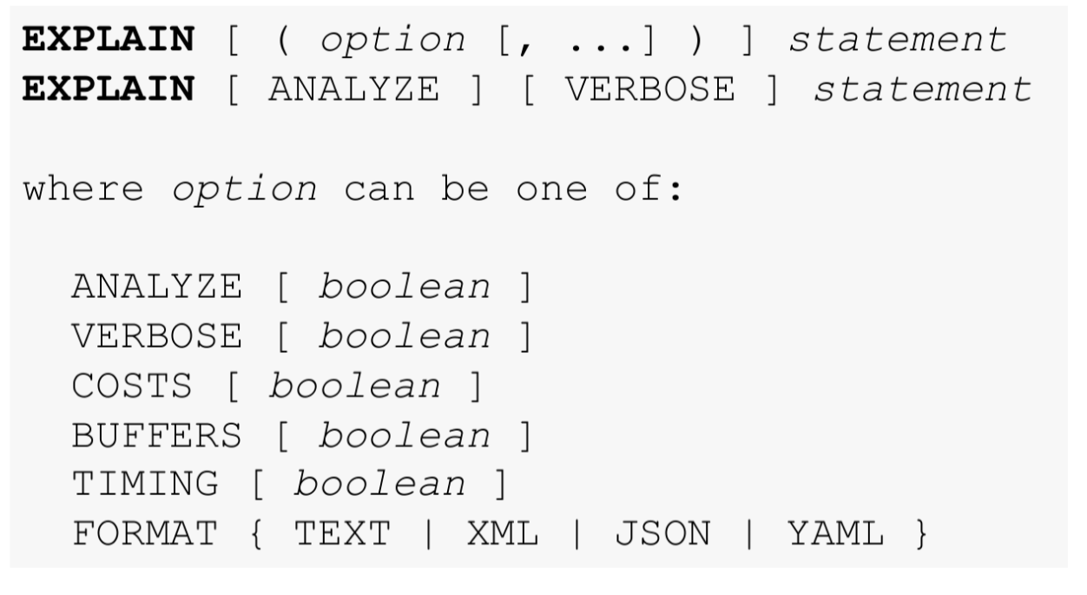
The EXPLAIN operator

Slide 19
ANALYZE operator
collects statistical information about the contents of tables in the database and stores the results in the pg_statistic system directory
analyzes all tables in the current database without parameters
if the table name is passed in the parameters, processes only the specified table
if a list of column names is passed in the parameters , statistics will be collected only for these columns
MISSING in the SQL standard

Slide 20
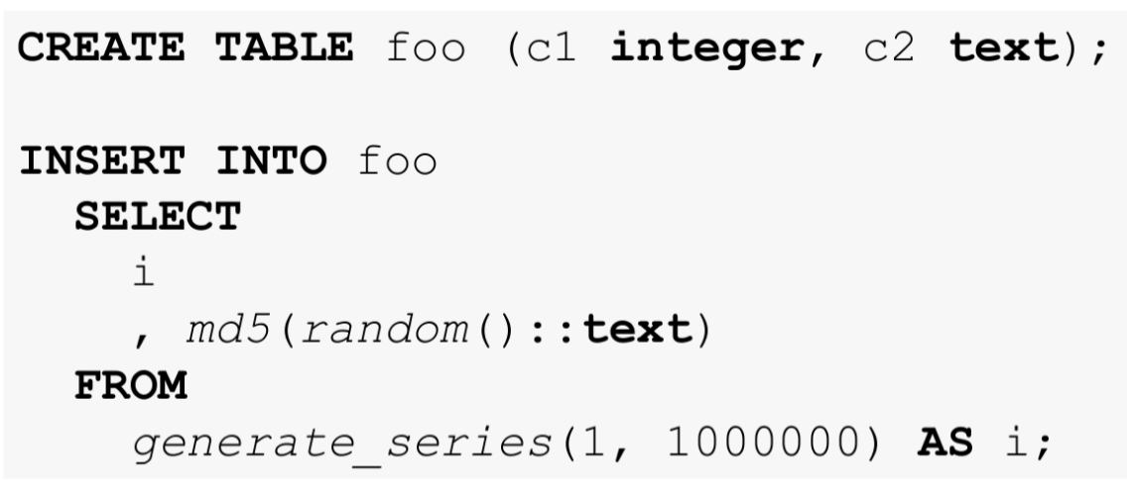
Query plan: test table

Slide 21
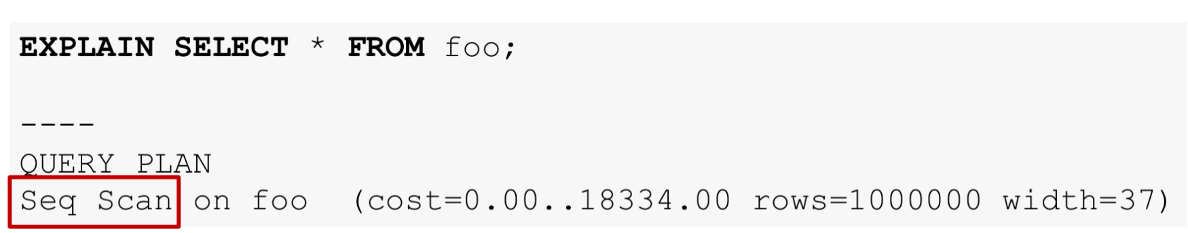
Query plan: simple sampling
There are several ways to read data from a table . In our case, EXPLAIN reports that Seq Scan is used — sequential, block by block, reading of table data.

Slide 22
Query plan: simple sampling
What is cost? This is not time, but a kind of spherical concept in a vacuum, designed to assess the cost of the operation.
The first value 0 is the cost of getting the first row.
The second is 18334 — the cost of getting all the lines.
rows — the approximate number of rows returned when performing the Seq Scan operation. Important! Now no rows are being subtracted from the table. At all. Therefore, the value is approximate.
width — the average size of a single string in bytes.

Slide 23
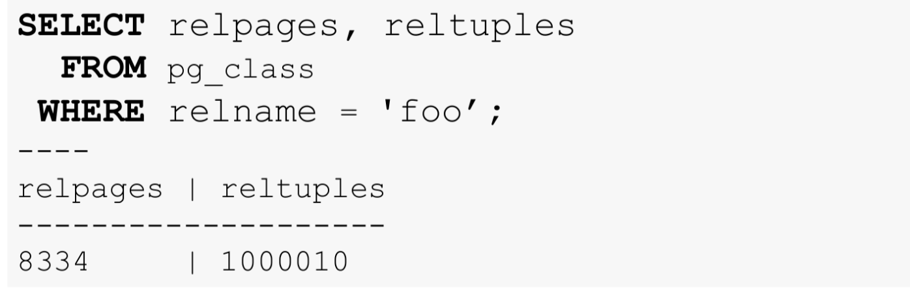
Where does the statistics come from?
Statistics are updated only when you run VACUUM or ANALYZE

Slide 24
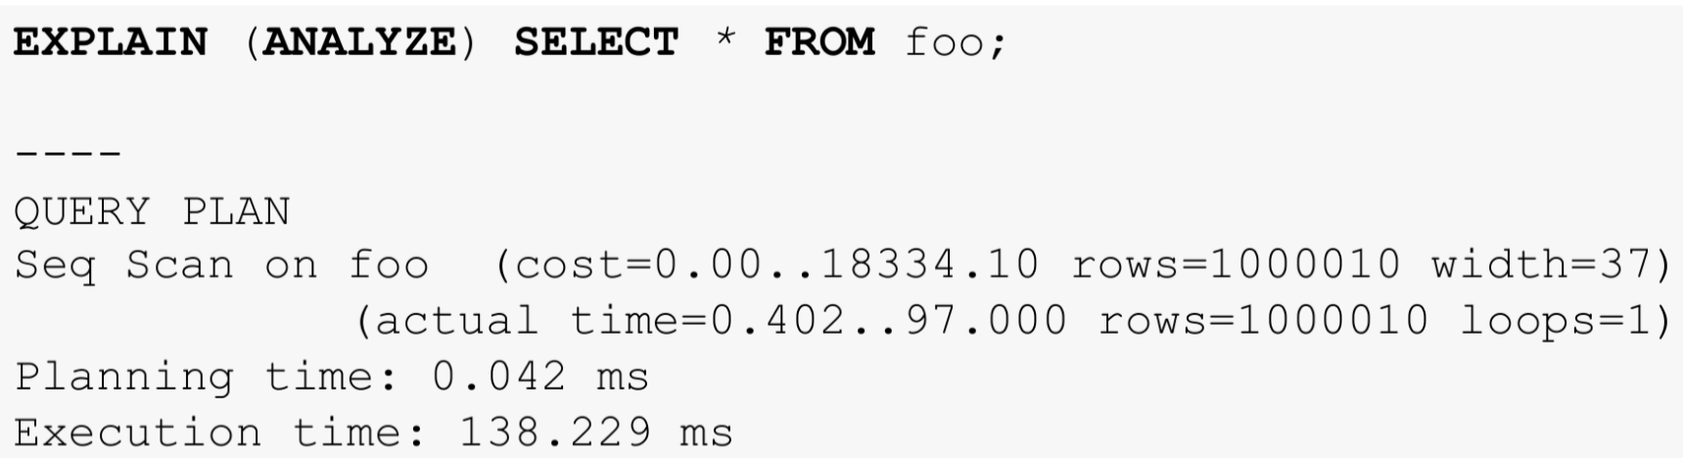
Query plan: simple sampling
Such a request will be executed in reality. If you do EXPLAIN (ANALYZE) for INSERT, DELETE or UPDATE, your data will change.
Don't forget about ROLLBACK

Slide 25
Indexes
Indexes in PostgreSQL are special database objects designed mainly to speed up data access.
These are auxiliary structures: any index can be deleted and restored from the information in the table.

Slide 26
Indexes
Indexes are database objects designed primarily to speed up data access
By using an index, the database server can find and retrieve the rows it needs much faster than without it. However, indexes are associated with an additional load on the DBMS as a whole, so they should be used carefully
Postgres core has 6 built-in types of indexes:
Btree (default)
hash
gist
spgist
gin
brin

Slide 27
Indexes: syntax
The syntax is complex and branched:
CREATE [ UNIQUE ] INDEX [ CONCURRENTLY ] [ [ IF NOT EXISTS ] name ] ON [ ONLY ] table_name [ USING method ]
( { column_name | ( expression ) } [ COLLATE collation_rule ] [ operator_class [ ( op_class_parameter = value [, ... ]) ] ] [ ASC | DESC ] [ NULLS { FIRST | LAST } ] [, ...] )
[ INCLUDE ( column_name [, ...] ) ]
[NULLS [NOT] DISTINCT]
[ WITH ( storage_parameter [= value] [, ... ]) ]
[ TABLESPACE table_space ]
[WHERE predicate]
But for ease of understanding it will be enough for us:
CREATE INDEX name ON table USING type (column)

Slide 28
Indexes: b-tree
B-trees can handle equality conditions and range tests with data that can be sorted in some order. The query planner may use such an index when the indexed column is subject to a comparison with one of the following operators: <, <=, =, >=, >
The optimizer can use these indexes in queries with the LIKE and ~ pattern comparison operators if the pattern is defined by a constant and it is bound to the beginning of the string - for example, col LIKE 'foo%' or col ~ '^foo', but not col LIKE '% bar'. By default this only works with the C locale (i.e. ASCII characters)

Slide 29
Indexes: hash
Hash indexes store a 32-bit hash code derived from the value of the indexed column, so hash indexes only work with simple equality conditions.
The query planner can apply a hash index only if the column being indexed is subject to a comparison with the = operator

Slide 30
Indexes: gist (generalized search tree)
It is not one specific index, but an "infrastructure" that allows many different indexing strategies to be implemented
Allows you to work, for example, with geometric objects, texts for full-text search, arrays and other complex data structures
Depending on the settings, it supports a large number of operators (for example, for two-dimensional geometric data types: <<, &<, &>, >> , <<|, &<|, etc.)

Slide 31
Indexes: spgist (space-partitioned generalized search tree)
Roughly speaking, we can say that this is a special case of gist
Supports indexing of data structured according to the “space sharing” principle. This means that spgist is effective for data that is naturally divided into disjoint subsets. spgist provides higher efficiency and smaller index size for certain types of queries and data structures compared to GIST

Slide 32
Indexes: gin (generalized inverted index)
This is an index type corresponding to the inverted index data structure
Effective for searching sets by their subsets (i.e. when the query is a subset of the desired set)

Slide 33
Indexes: brin (block range index)
Designed to work with very large tables where the data is relatively ordered by the value of the indexed column
Stores generalized information about the values located in physically sequentially located blocks of the table. Therefore, such indexes are most effective on columns whose values correlate well with the physical order of the table columns

Slide 34
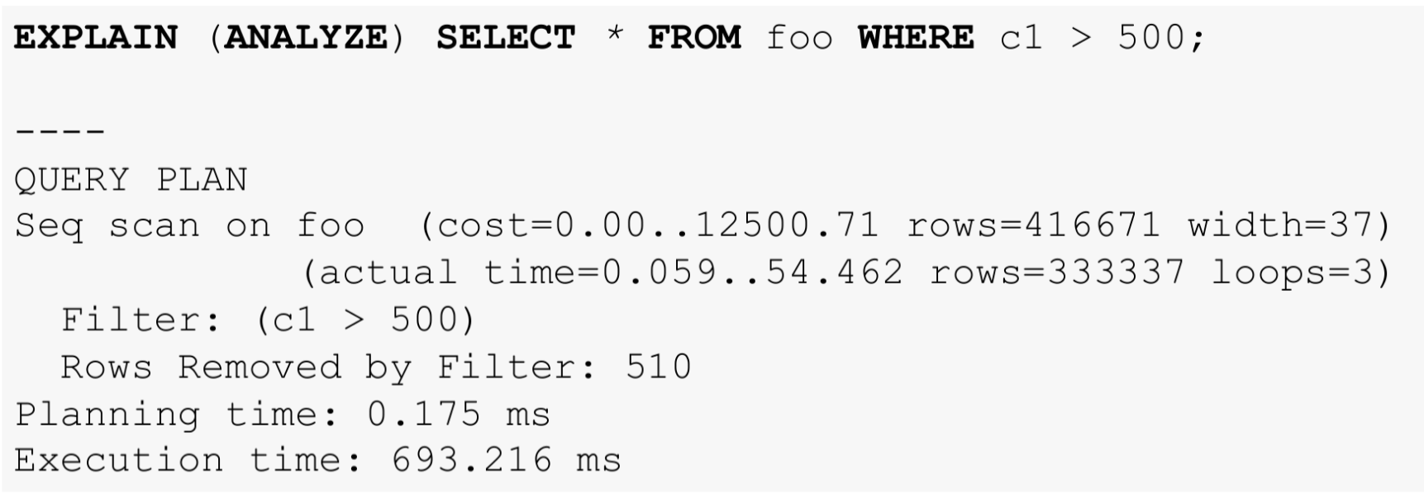
Query plan: WHERE

Slide 35
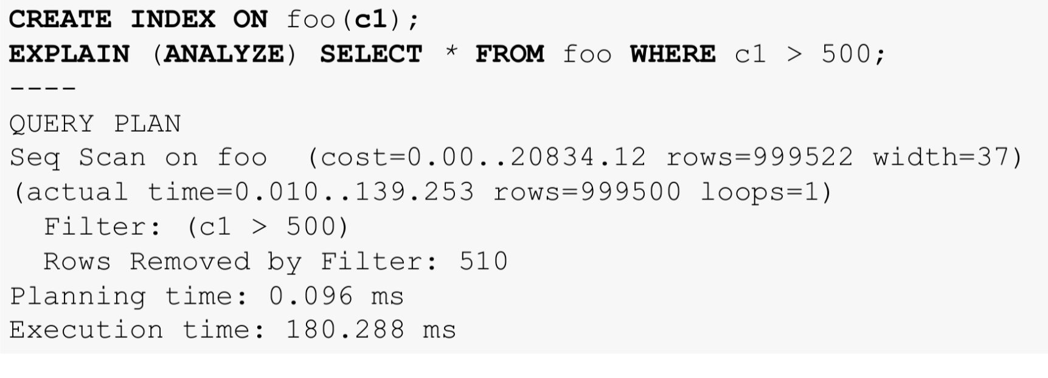
Query plan: WHERE + INDEX (many rows)

Slide 36
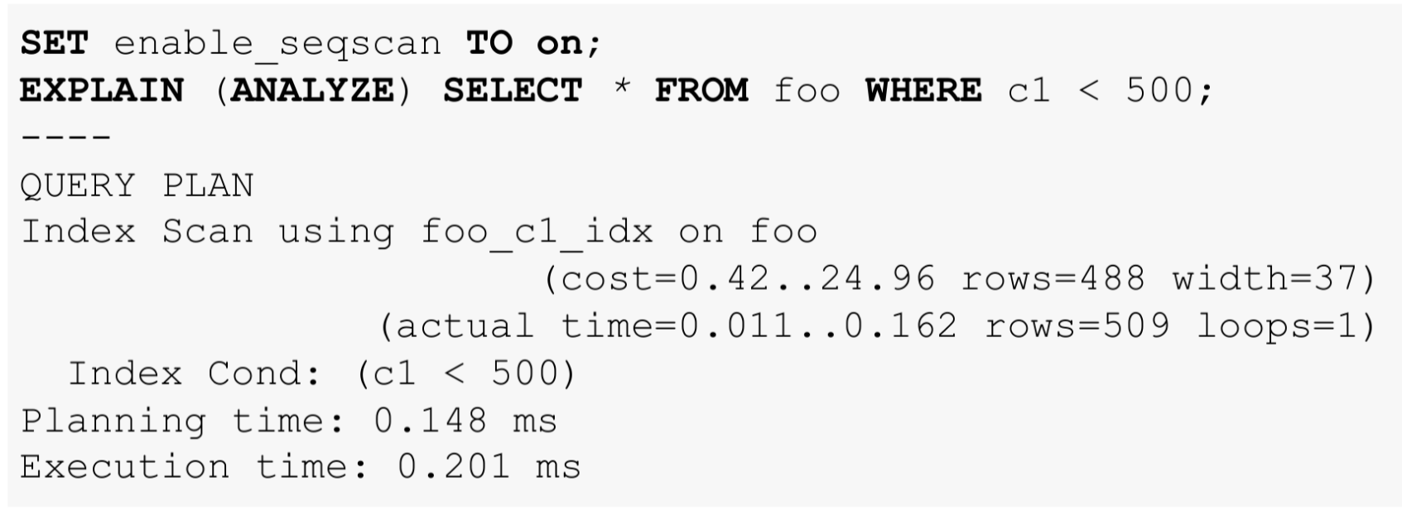
Query plan: WHERE + INDEX (few rows)

Slide 37
Query plan: subtotal
Now we know:
Seq Scan — the whole table is read.
Index Scan — an index is used for WHERE conditions, reads the table when selecting rows.
Bitmap Index Scan — first Index Scan, then sampling control by table. Effective for a large number of rows.
Index Only Scan is the fastest. Only the index is read.

Slide 38
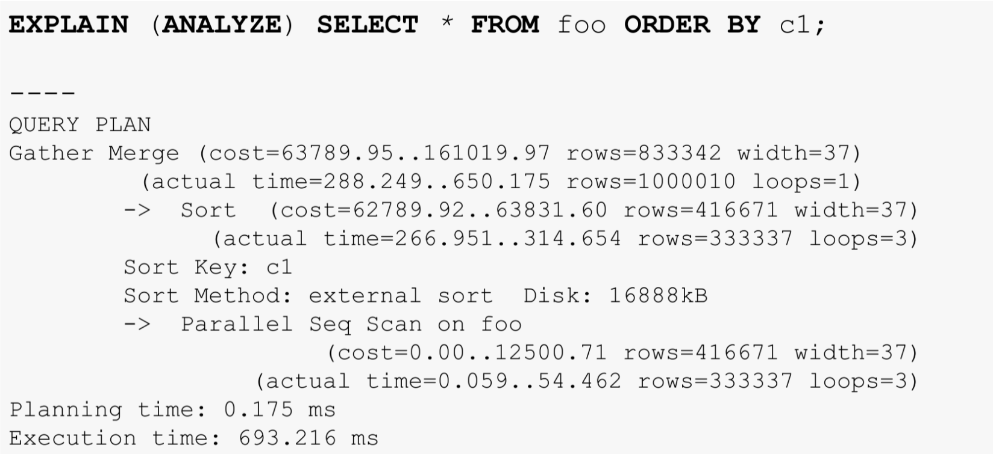
Request plan: ORDER BY

Slide 39
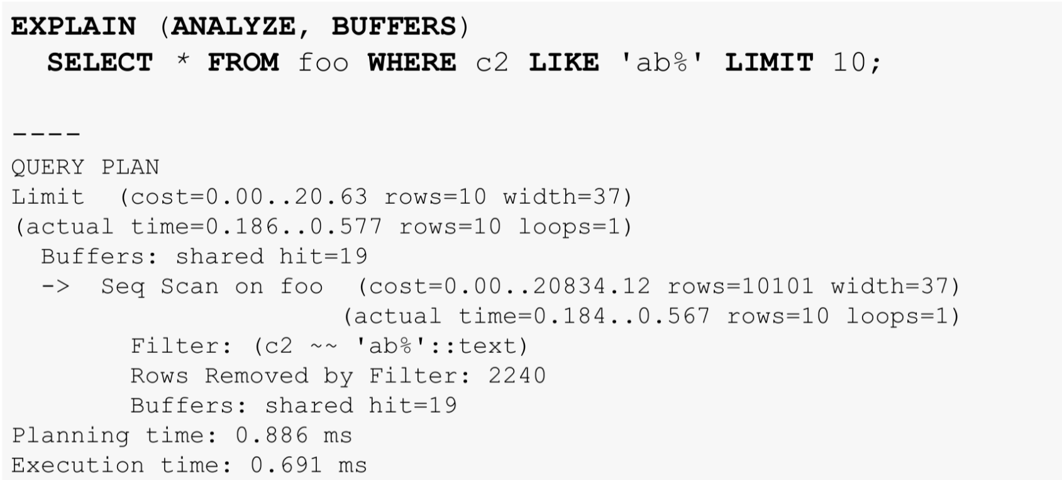
Query Plan: LIMIT

Slide 40
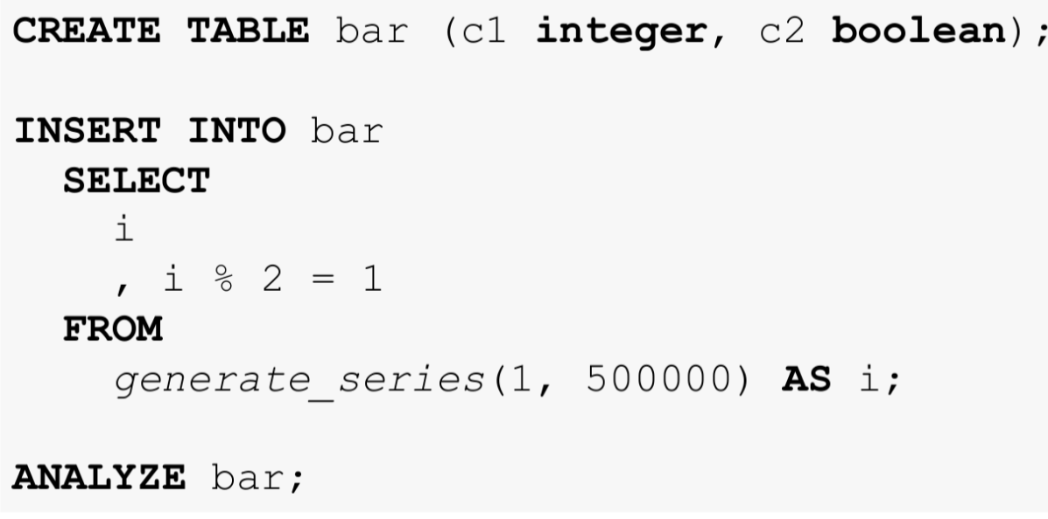
Query Plan: JOIN

Slide 41
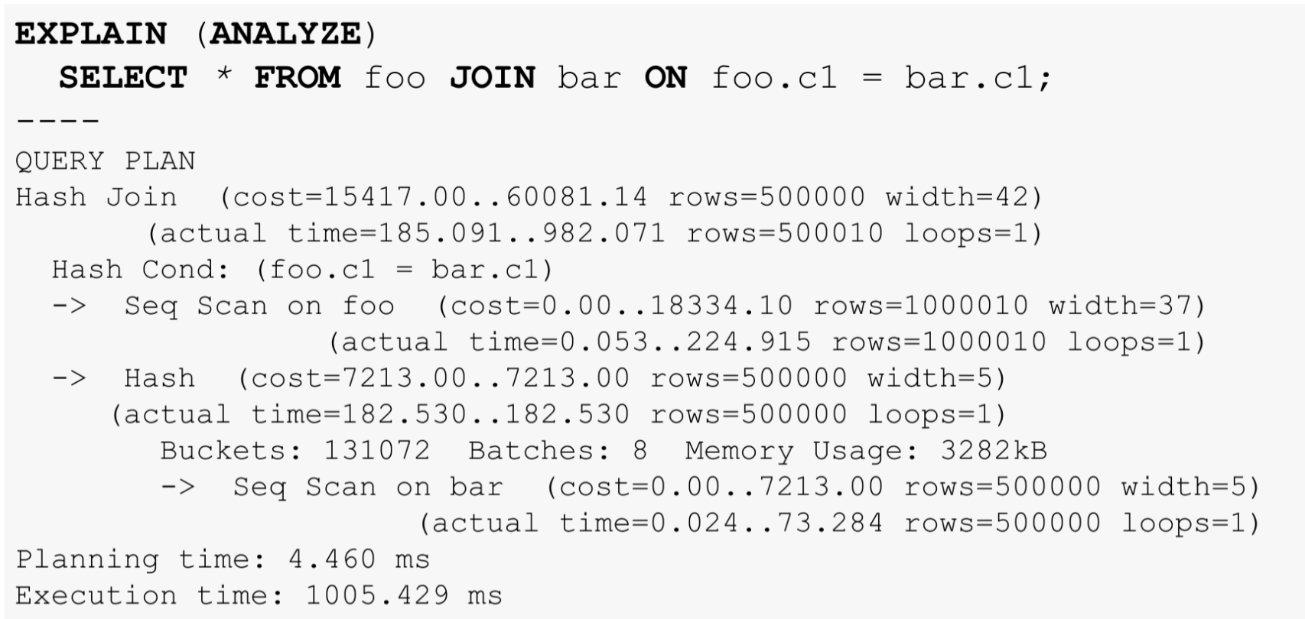

Slide 42
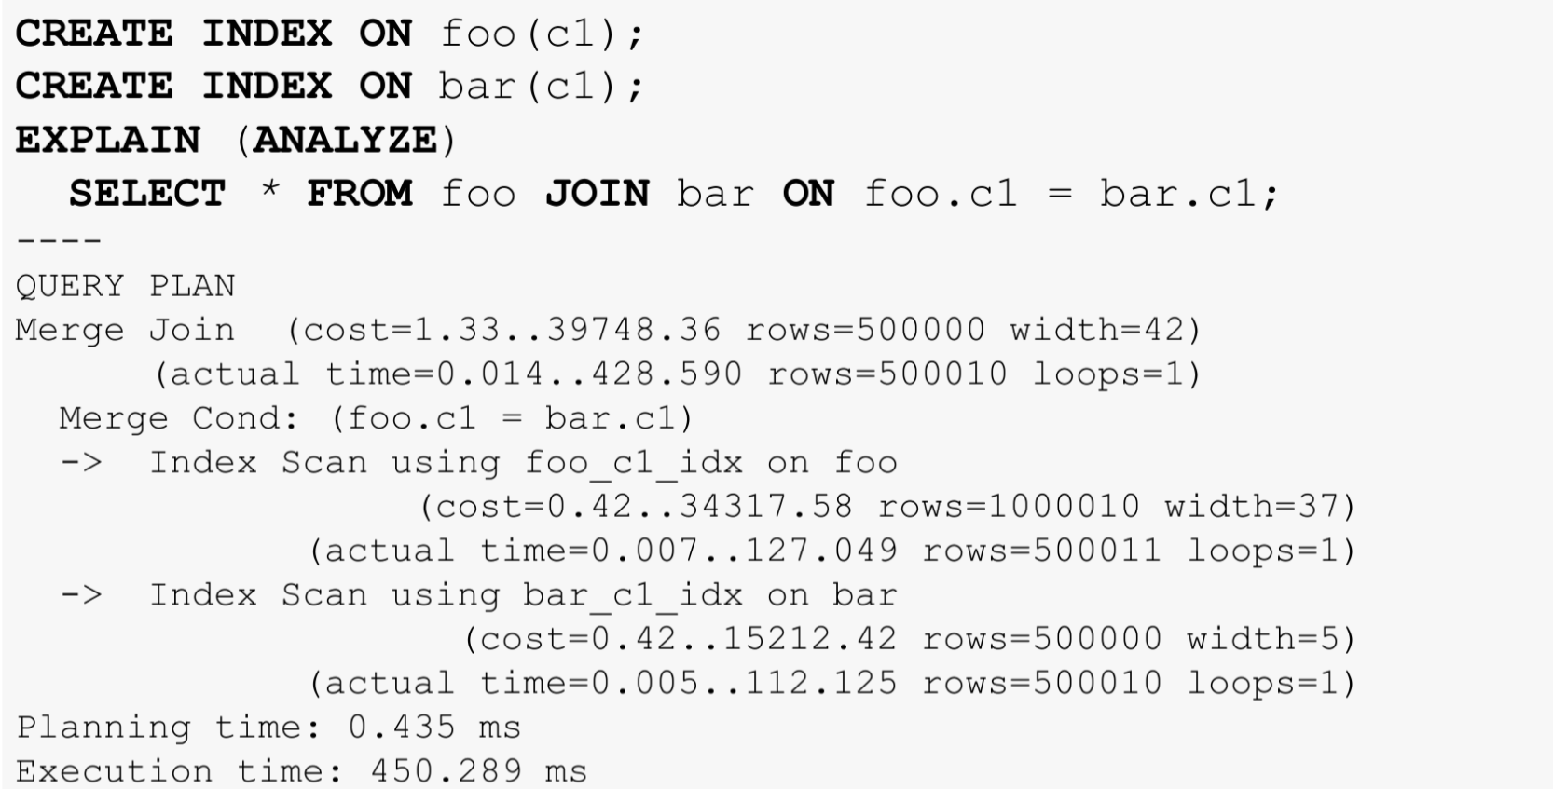
Query plan: JOIN + INDEX

Slide 43
Query Plan: Join Methods
Nested loop (pseudocode):
for i in first_table:
for j in second_table where second_table.i = i:
check the conditions and form a string
Hash join (pseudocode):
build a hash table from first_table
for j in second_table:
if key_exists(hash(second_table.j)):
check the conditions and form a string
Merge join (pseudocode):
merge two sorted first_table and second_table
check the conditions and form a string

Slide 44
Query plan: Nested loop
Behind:
Very cheap
Very fast on small volumes
Does not require a lot of memory
Ideal for lightning fast queries
The only one can connect not only by equality
Against:
Doesn't work well for large amounts of data

Slide 45
Query plan: Hash join
Behind:
No index needed
Relatively fast
Can be used for FULL OUTER JOIN
Against:
Loves memory
Equality join only
Dislikes many values in join columns
Long time to get the first line

Slide 46
Query plan: Merge join
Behind:
Fast on large and small volumes
Does not require a lot of memory
Can OUTER JOIN
Suitable for joining more than two tables
Against:
Requires sorted data streams, which means or index, or sort
Equality join only

Slide 47
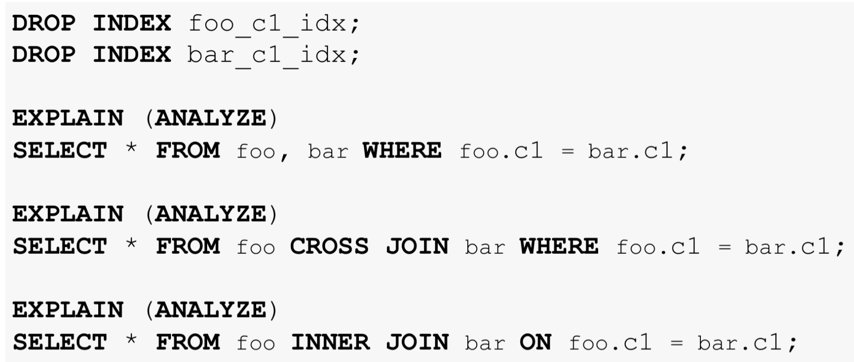
The planner is not stupid

Slide 48
Links
https://www.dalibo.org/_media/understanding_explain.pdf
http://langtoday.com/?p=229
http://langtoday.com/?p=270
https://habr.com/ru/post/203320/

